Slide 1

RUNGTA COLLEGE OF DENTAL SCIENCES AND RESEARCH
DIARRHOEA
DEPARTMENT OF GENERAL MEDICINE

Slide 2
SPECIFIC LEARNING OBJECTIVES
MUST KNOW | NICE TO KNOW | DESIRE TO KNOW
WHAT IS DIARRHOEA? | CAUSES | WHY DOES IT HAPPEN?
CHARACTERISTICS OF DIARRHOEA | DIAGNOSTIC TESTS
TRATMENT

Slide 3
CONTENTS
What is diarrhoea?
Why does it happen?
Causes
Characteristics of diarrhoea
Treatment
Diagnostic tests
Summary

Slide 4
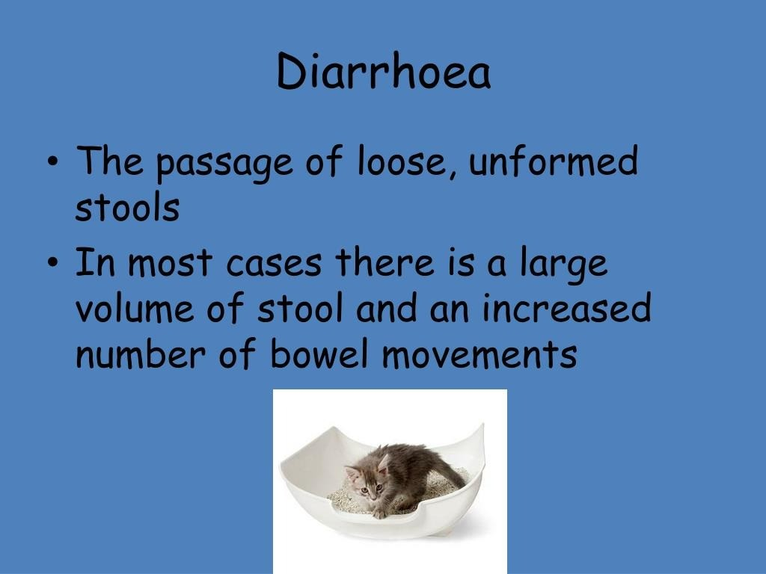

Slide 5
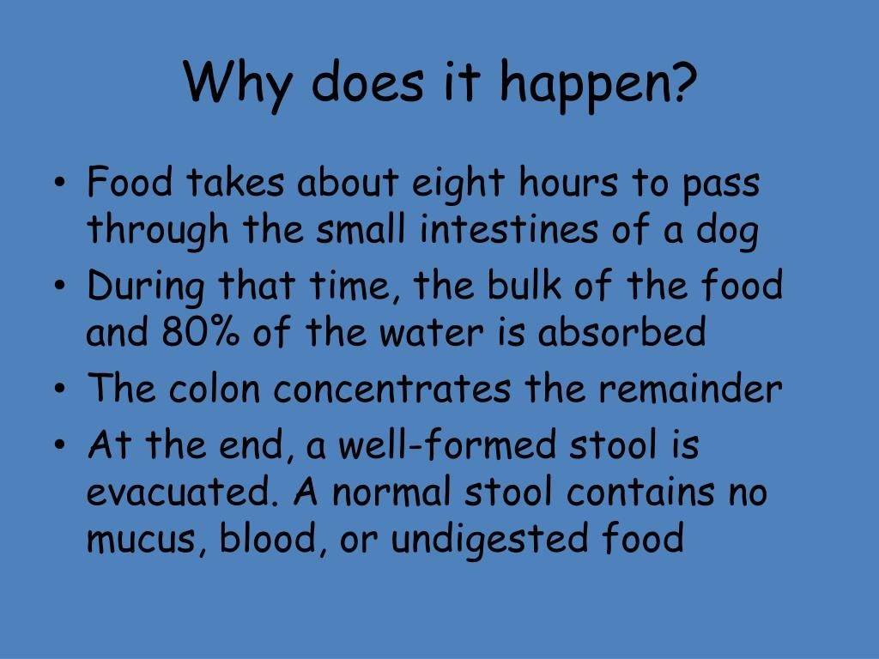

Slide 6
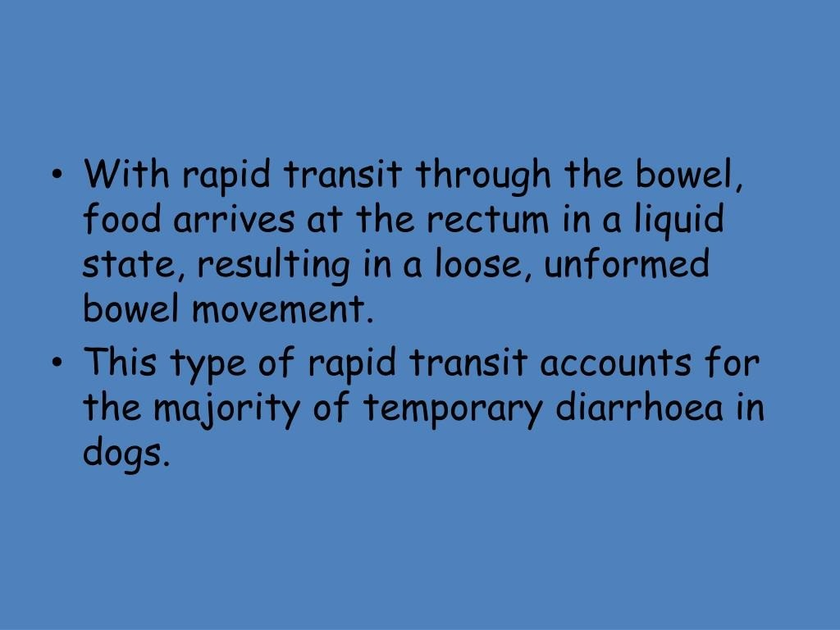

Slide 7
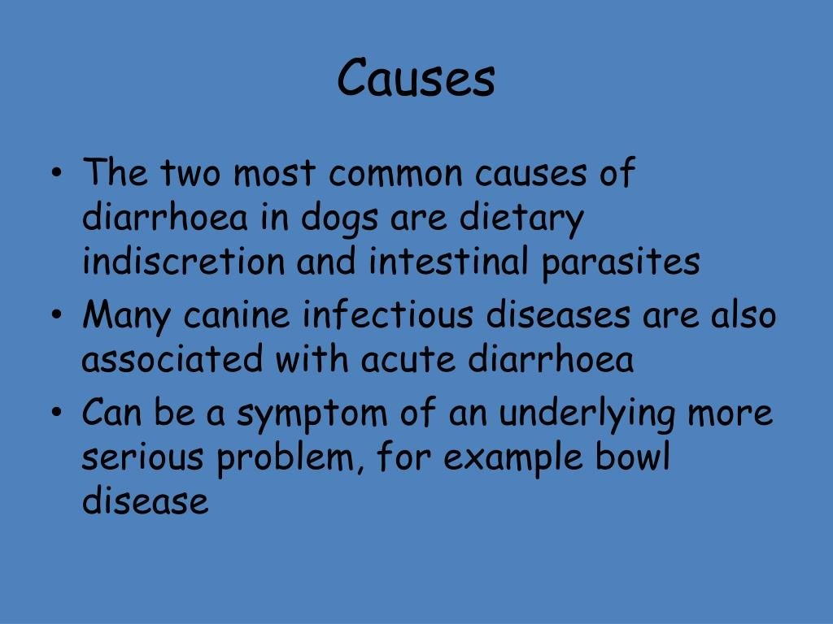

Slide 8
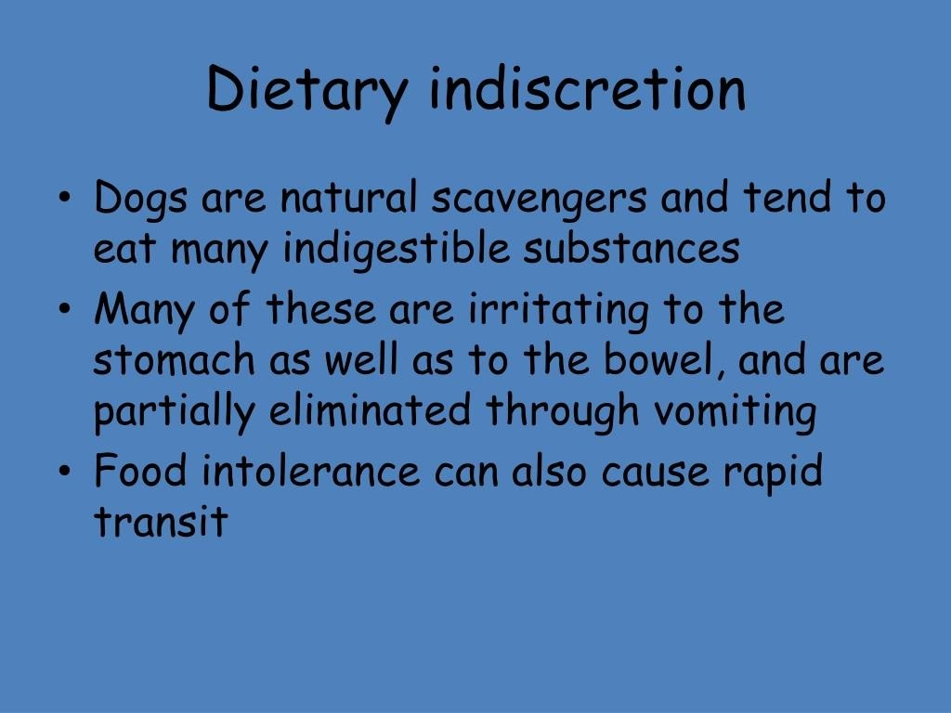

Slide 9
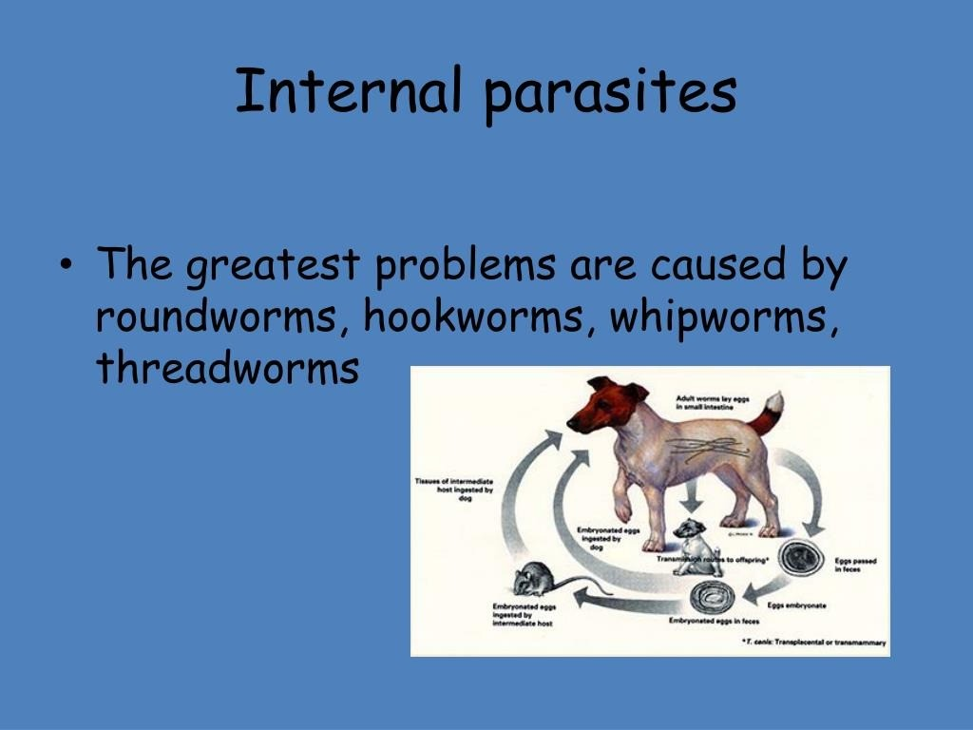

Slide 10
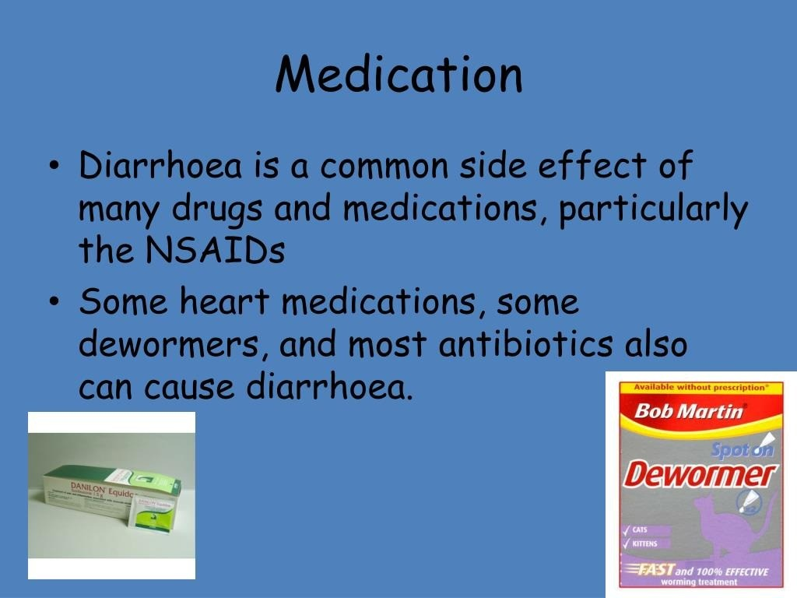

Slide 11
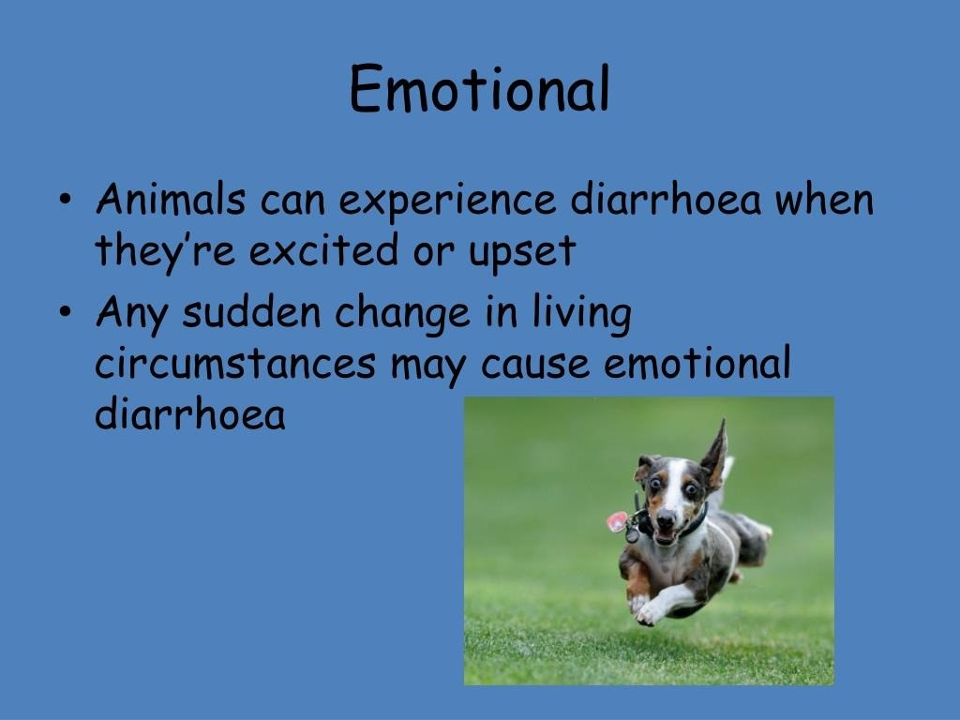

Slide 12
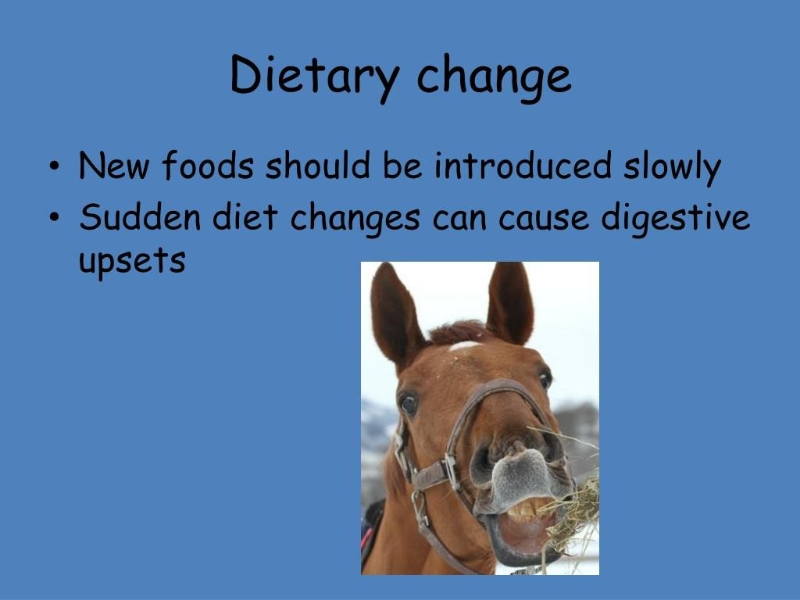

Slide 13
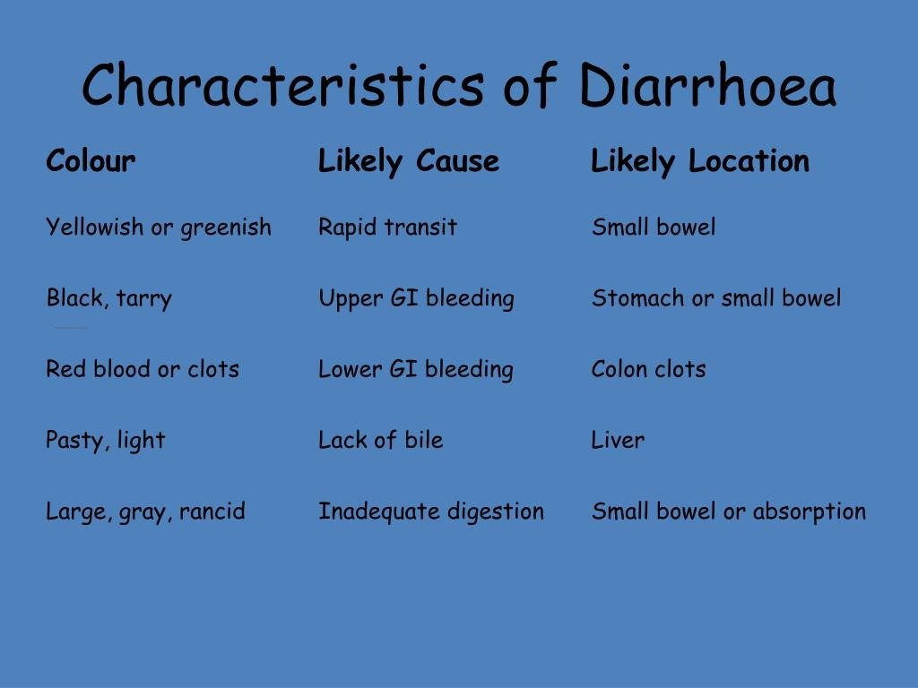

Slide 14
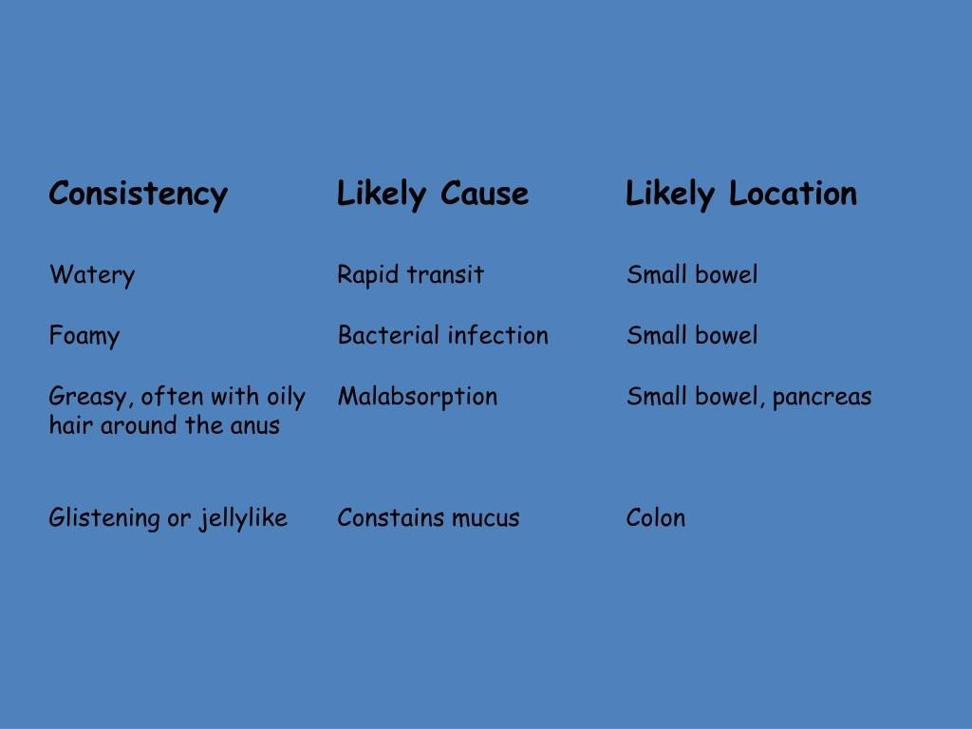

Slide 15
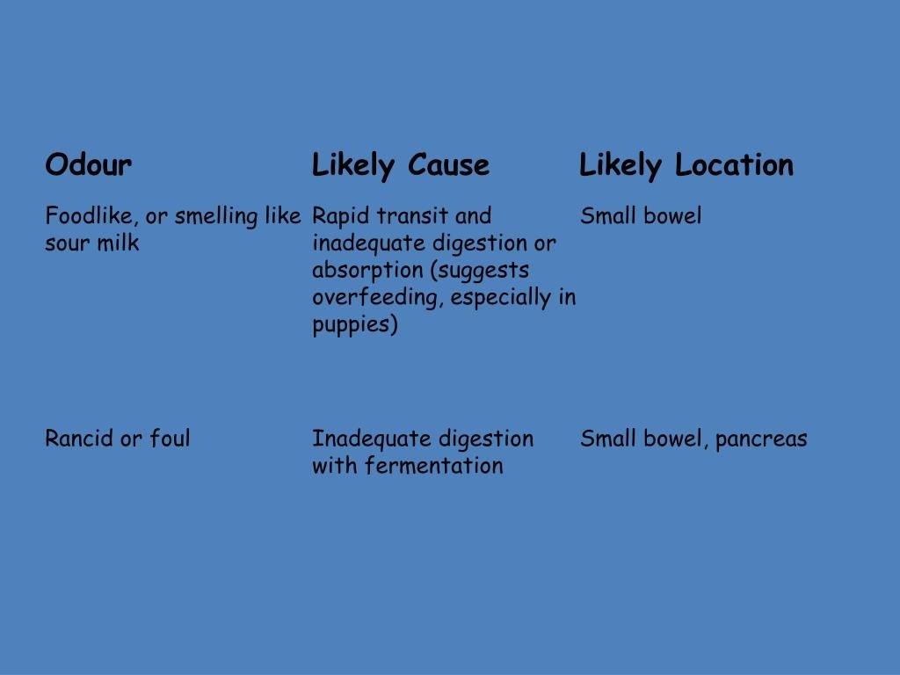

Slide 16
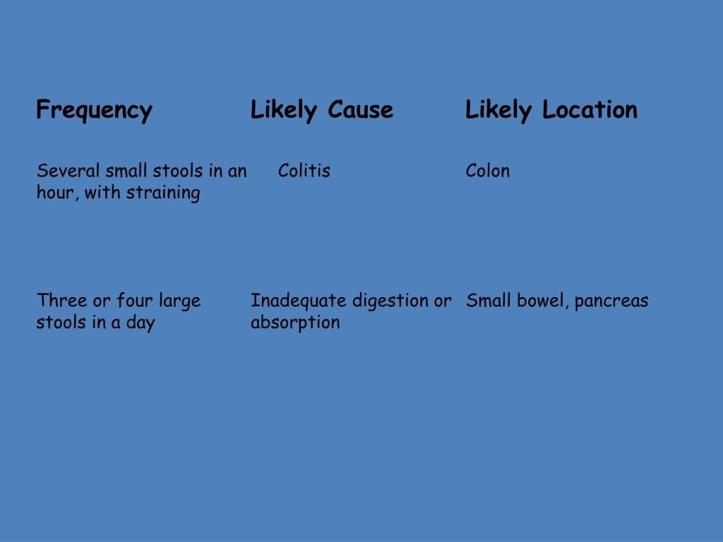

Slide 17
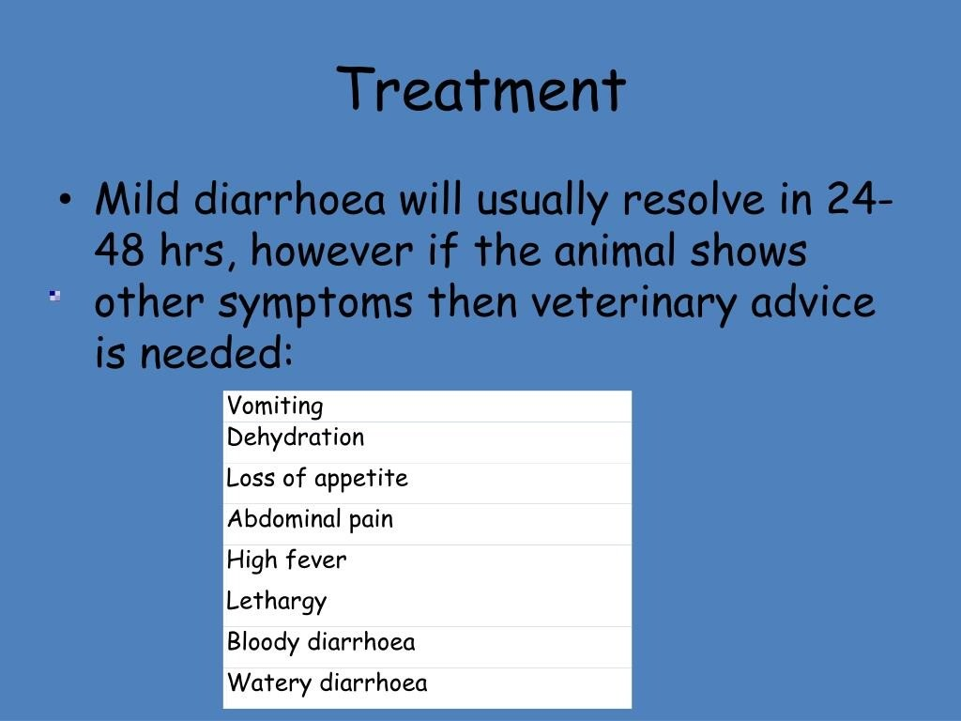

Slide 18
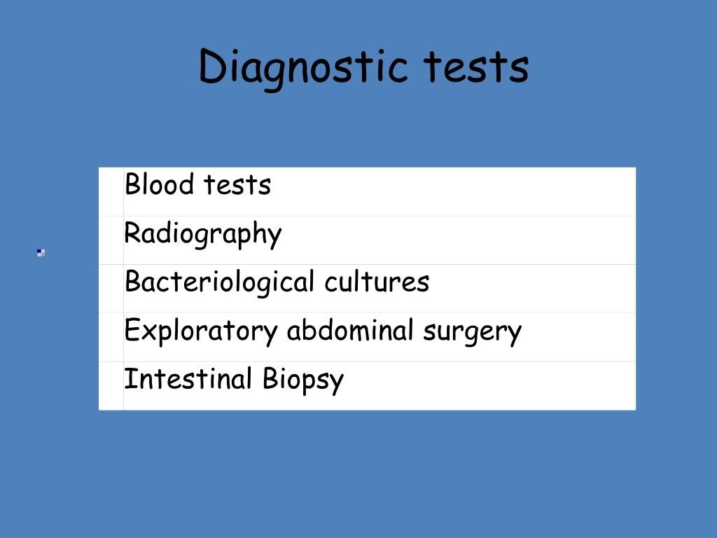

Slide 19
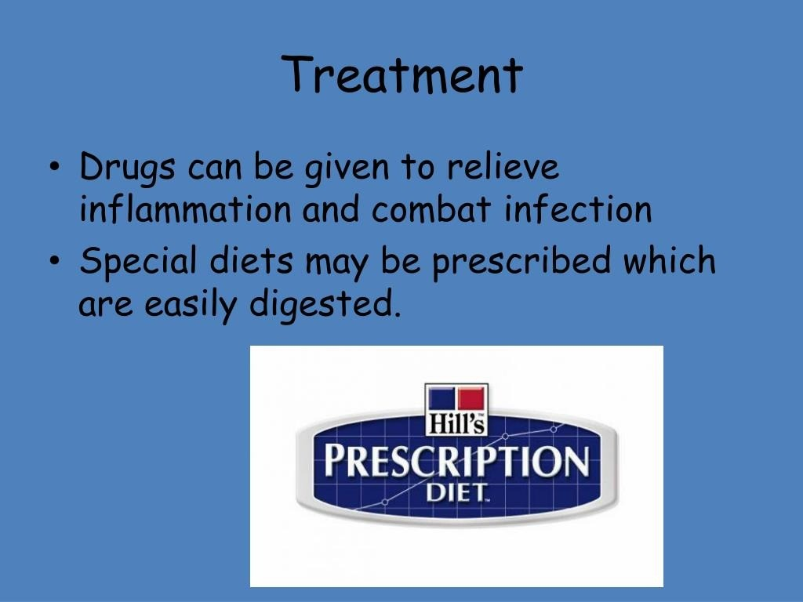

Slide 20
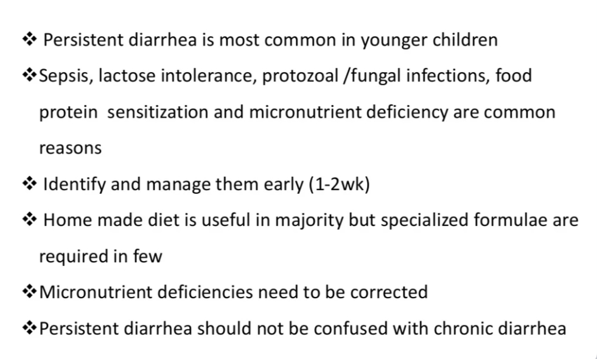
SUMMARY

Slide 21
REFERENCES
DAVIDSON’S PRINCIPLES AND PRACTICE OF MEDICINE; 23rd edition
HARRISON’S PRINCIPLE OF INTERNAL MEDICINE; 21ST edition
TEXTBOOK OF CLINICAL MEDICINE by S.N Chugh ;5th edition

Slide 22
QUESTION AND ANSWERS

Slide 23
THANK YOU....

